Slide 1
Hospital Management System
-Team BITWISE (WFS7-Team2)

Slide 2
Team Members
Frontend Team
SIDHARTH SUDHEER
TANISHKA PRAMOD RAKTE
HEMANT RAJ
Backend Team
SRITAM MISHRA
SIDDHANT VIJAY HOLE
SAKSHI SUSHANT BELSARE
PARUL SUBHASH PATLE

Slide 3
About the Application
The project is a comprehensive web application designed to streamline hospital operations by efficiently managing key services such as patient records and doctor appointments. It offers distinct interfaces for Admins, Doctors, and Hospital Staff, enabling each role to perform specific tasks related to hospital management. Admins can oversee the entire system, doctors can manage their appointments, and staff members can handle patient registrations and appointment bookings. This system aims to enhance operational efficiency, reduce manual errors, and improve overall service delivery within the hospital.

Slide 4
Features
Appointment Booking: Allows users to book appointments with doctors on behalf of patients, ensuring that the doctor's schedule is available.
Doctor Registration: Admin can register doctors into the system with all necessary details.
Doctor Schedule Management: Admin can view, update, and manage doctors' schedules, including canceling all appointments if a doctor becomes unavailable.
Doctor Schedule Setup: Doctors are required to set up their schedules every 3 days, ensuring that the system remains up-to-date with their availability.

Slide 5
Doctor Schedule Adjustments: Doctors can update their schedules to reflect unavailability on specific days or other changes.
Doctor Appointment Management: Doctors can view, update, and cancel appointments, as well as suggest future medications and medical tests for patients.
Admin Authority: Admin has the authority to modify doctor schedules, remove or update doctor details, and manage appointments.
Reporting: The admin can pull comprehensive reports on doctors, appointments, patients, and other relevant system data for analysis and management.

Slide 6
Technologies Used
HTML (HyperText Markup Language):
Usage: Structures the content of the web pages within the system.
Where Used: All pages including the login, staff dashboard, admin dashboard, doctor dashboard, and forms for booking appointments, registering patients, and managing schedules.
CSS (Cascading Style Sheets):
Usage: Styles the HTML elements, providing visual design, layout, and responsiveness to the web pages.
Where Used: Applied across all web pages for consistent styling, including color schemes, fonts, layout structure, and responsive design elements.

Slide 7
JavaScript:
Usage: Implements dynamic functionality and interactivity within the web pages.
Where Used: Used for form validation, handling user input (e.g., auto-populating patient and doctor names), managing local storage for user credentials, and performing actions such as booking appointments and updating schedules.
Java:
Usage: Powers the backend of the system, handling business logic, data processing, and communication with the database.
Where Used: Utilized in the server-side application to manage user roles, process requests from the frontend, and execute backend operations like scheduling, appointment management, and generating reports.

Slide 8
JDBC (Java Database Connectivity):
Usage: Facilitates interaction between the Java application and the relational database.
Where Used: Used for database operations, such as storing and retrieving doctor, patient, and appointment details, executing queries for report generation, and managing transactions to ensure data integrity.

Slide 9
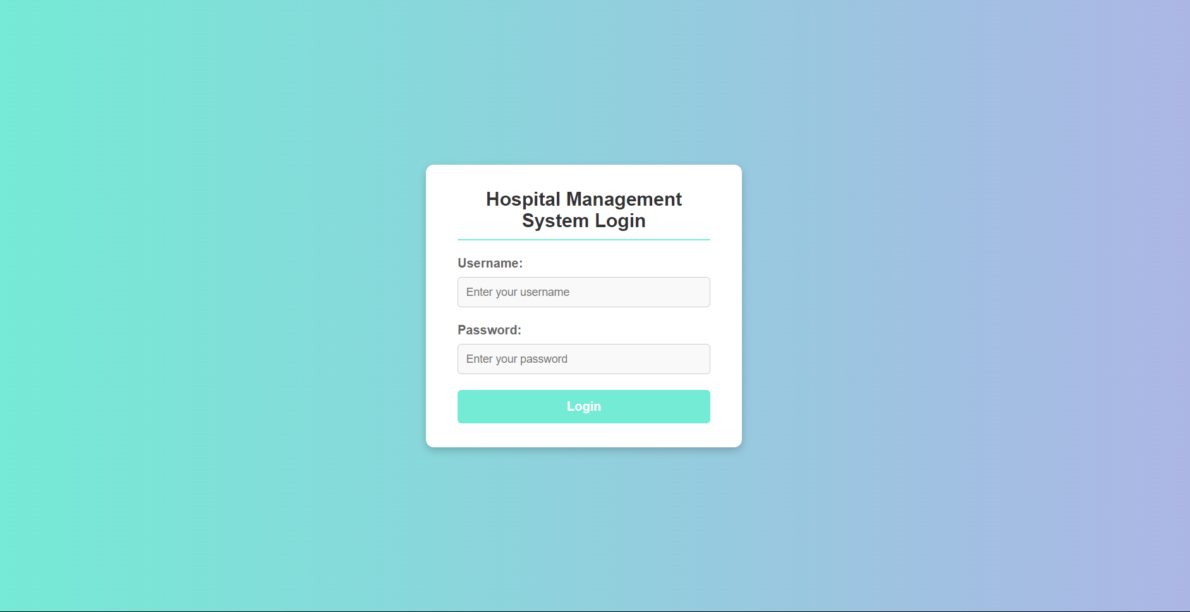
Snapshots
Single Point Entry Login

Slide 10
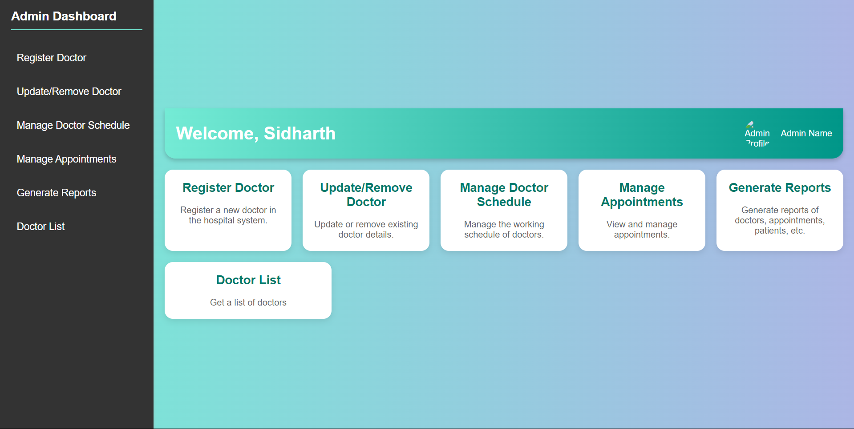
Admin Homepage

Slide 11
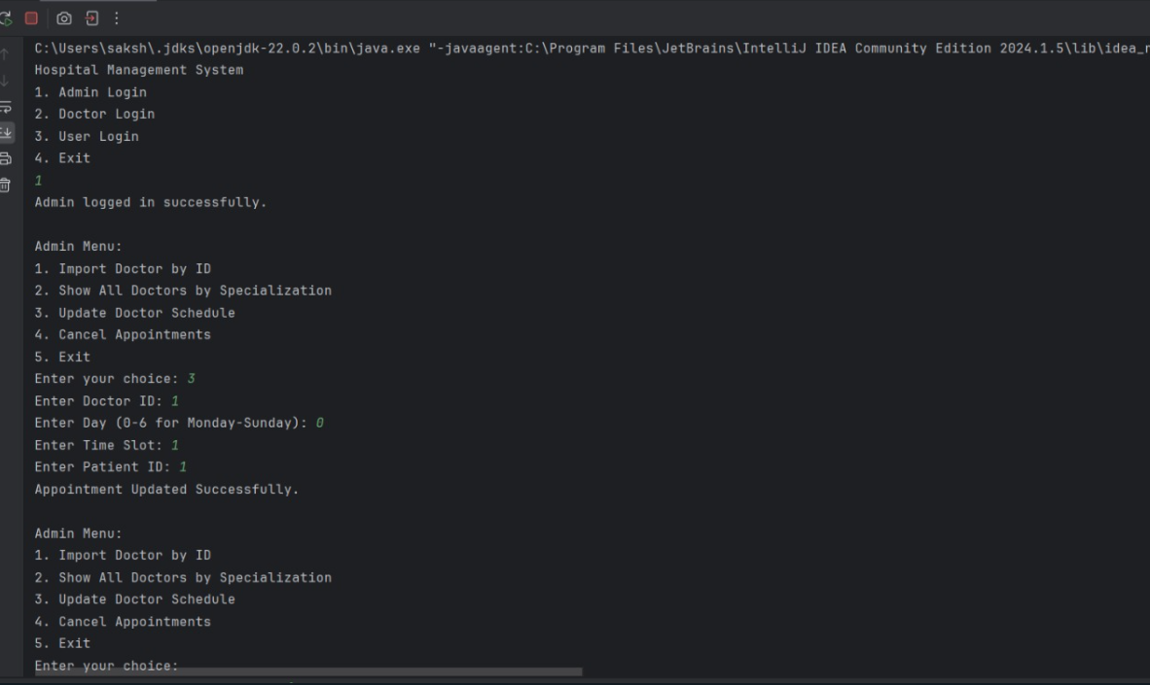
Console view of Backend

Slide 12
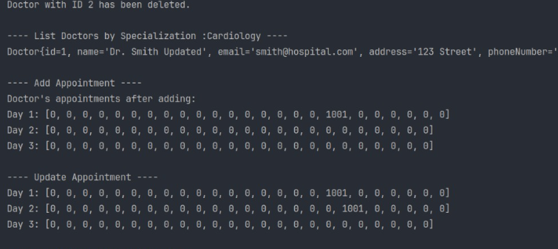
Backend Appointment Structure

